Slide 1
Approximation Algorithms For Protein Folding Prediction
Giancarlo MAURI,Antonio PICCOLBONI and Giulio PAVESI
Symposium on Discrete Algorithms, pp. 945-946, 1999
Reporter: Chia-Chang Wang
Date: Nov. 26,2004

Slide 2
Abstract
We present a new polynomial-time algorithm for the protein folding problem in the two-dimensional HP model introduced by Dill, which has been recently proved to be NP-hard. Our algorithm guarantees a performance ratio of l/4, equaling the two best polynomial-time performances guaranteed algorithms for this problem. However, experimental results on a large set of random instances have shown an average performance ratio for our algorithm of 0.67, versus 0.55 and 0.48 for the other two.

Slide 3
Outline
1.Introduction
2.The HP Model
3.Context-free Grammars For Protein Folding Prediction
4.Experimental Evaluation
5.Conclusions

Slide 4
1.Introduction
Proteins are polymer chains of amino acid residues of 20 different kinds.
Native state of proteins
  Determine the macroscopic properties, function and behavior of proteins
  Determined uniquely by the position of the different residues in the chain
Possible conformations of proteins are analyzed in terms of their free energy

Slide 5
1.Introduction
According to the Thermodynamical Hypothesis, the native structure of a protein is the one corresponding to a global minimum of its free energy.
The protein folding prediction problem can be recast as an energy minimization problem

Slide 6
2.The HP Model
HP model: two dimensional hydrophobic-hydrophilic model
The amino acid residues can be divided in two classes:
H: Hydrophobic
P: Hydrophilic
The protein instance can be reduced to a binary sequence of H’s and P’s. ex:PHHHHP
The conformational space is discretized into a square lattice ( two-dimensional grid).
H
H
P
H
H
P

Slide 7
2.The HP Model
Connected neighbors vs topological neighbors
The free energy function for this model is based on the number of hydrophobic ( H ) residues that are topological neighbors.
Every H…H topological neighbor on the lattice brings a free energy of e (≦ 0 ). Every other neighbor has a free energy of 0.
H
H
P
H
H
P

Slide 8
2.The HP Model
Following the Thermodynamical Hypothesis, the native conformation is the one that minimizes the free energy, that is maximizes the number of H topological neighbors.
The protein folding problem in the two-dimensional HP model is NP-hard.
H
H
P
H
H
P

Slide 9
3.Context-free Grammars for Protein Folding Prediction
3.1 The algorithm
s = s₀s₁…s_{n} where s_{i}∈ {H, P}.
1.Define an ambiguous grammar.
2.Define a relation between the derivations of the grammar and a subset of all the possible layouts.
3.Assign to every production of the grammar an appropriate score.
4.Apply a parsing algorithm to find the tree with the highest score.

Slide 10
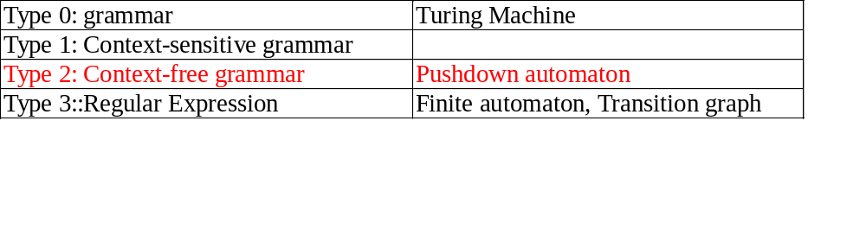
3.1 The Algorithm
Recall
Context-free Grammar
  G=( N, Σ∪{ Λ } , S, P )
  P ⊆ ( N, (N∪Σ)* )

Slide 11
3.1 The Algorithm
Recall
Ambiguous grammar
E → E+E
E →E * E
E →0 | 1 | 2 | …| 9
A sentence 6+3*8
E
E
E
+
E
E
*
E
6
E
*
E
E
+
E
8
3
8
6
3

Slide 12
3.1 The Algorithm
1.Define an ambiguous grammar that generates all the possible protein instances(i.e. strings of H’s and P’s of arbitrary length)
G={N, T, S, P}, where :
T={H, P, U} is the set of terminal symbols
N={S, L, R} is the set of the non-terminal symbols
R is the start symbol (the root of every parse tree)
P is the set of the production

Slide 13
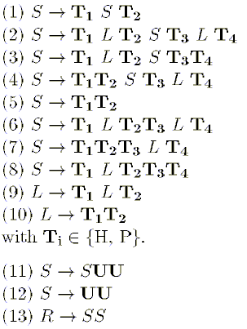
3.1 The Algorithm
Class (1) production
P is the set of the production
S → H S H, S → H S P, S → P S H , S → P S P

Slide 14
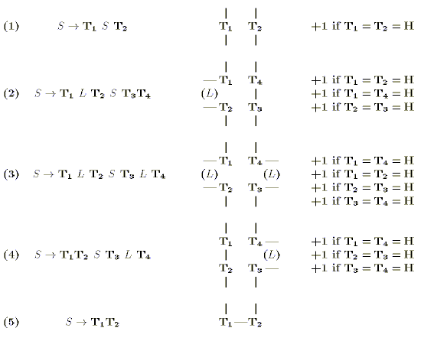
3.1 The Algorithm
2.Define a relation between the derivations of the grammar and a subset of all the possible layouts.
3.Assign to every production of the grammar an appropriate score.

Slide 15
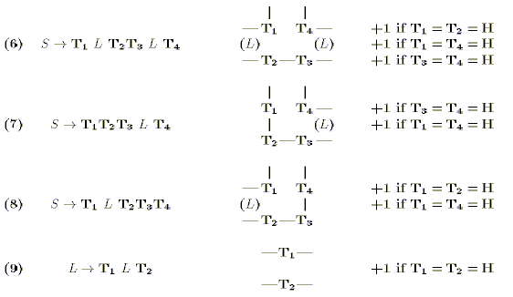
3.1 The Algorithm
2.Define a relation between the derivations of the grammar and a subset of all the possible layouts.
3.Assign to every production of the grammar an appropriate score.
(10) L →T₁T₂ ——T₁ —T₂ ——

Slide 16
3.1 The Algorithm
4.Apply a parsing algorithm to find the tree with the highest score(computed as the sum of the scores of the productions of the tree), that is,the tree corresponding to the layout with minimal energy in the subset generated by the grammar.
The parsing algorithm preserves its worst case time (O(n³)) and space (O(n²)).
(10) L →T₁T₂ ——T₁ —T₂ ——

Slide 17



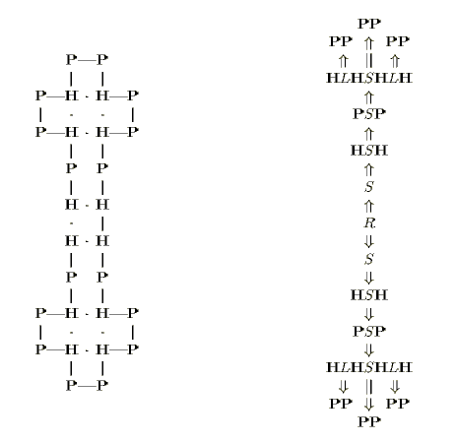
(10) L →T₁T₂ ——T₁ —T₂ ——
(10) L →T₁T₂ ——T₁ —T₂ ——
Sequence:HPHPPHPPHPPHPHHPHPPHPPHPPHPH

Slide 18
4 .Experimental Evaluation
Algorithm
B
C
CFG
Algorithm B and C
William E. Hart, Sorin C. Istrail
Fast Protein Folding in the Hydrophobic-Hydrophilic Model Within Three-eights of Optimal.
In Journal of computational biology, spring 1996
Time Complexity
O(n)
O(n²)
O(n³)
Guaranteed Absolute Performance Ratio
1/4
1/4
1/4
Guaranteed Asymptotic Performance Ratio
1/4
1/4
1/4
Average Performance Ratio P_{H}=0.15
0.52
0.60
0.79
Average Performance Ratio P_{H}=0.33
0.48
0.57
0.72
Average Performance Ratio P_{H}=0.5
0.48
0.55
0.68
Average Performance Ratio P_{H}=0.66
0.48
0.53
0.63
Average Performance Ratio P_{H}=0.85
0.48
0.50
0.55
Average Performance Ratio (overall)
0.48
0.55
0.67
Worst case Performance Ratio Found
0.25
0.33
0.375

Slide 19
5 .Conclusions
The lower bounds for the performance ratios of our algorithm equal the performance ratios of the best two algorithms.
Conjecture:
A tight bound to the performance of our algorithm ( or of an improvement of it) could be in fact the experimental one , that is 3/8.

